Slide 1
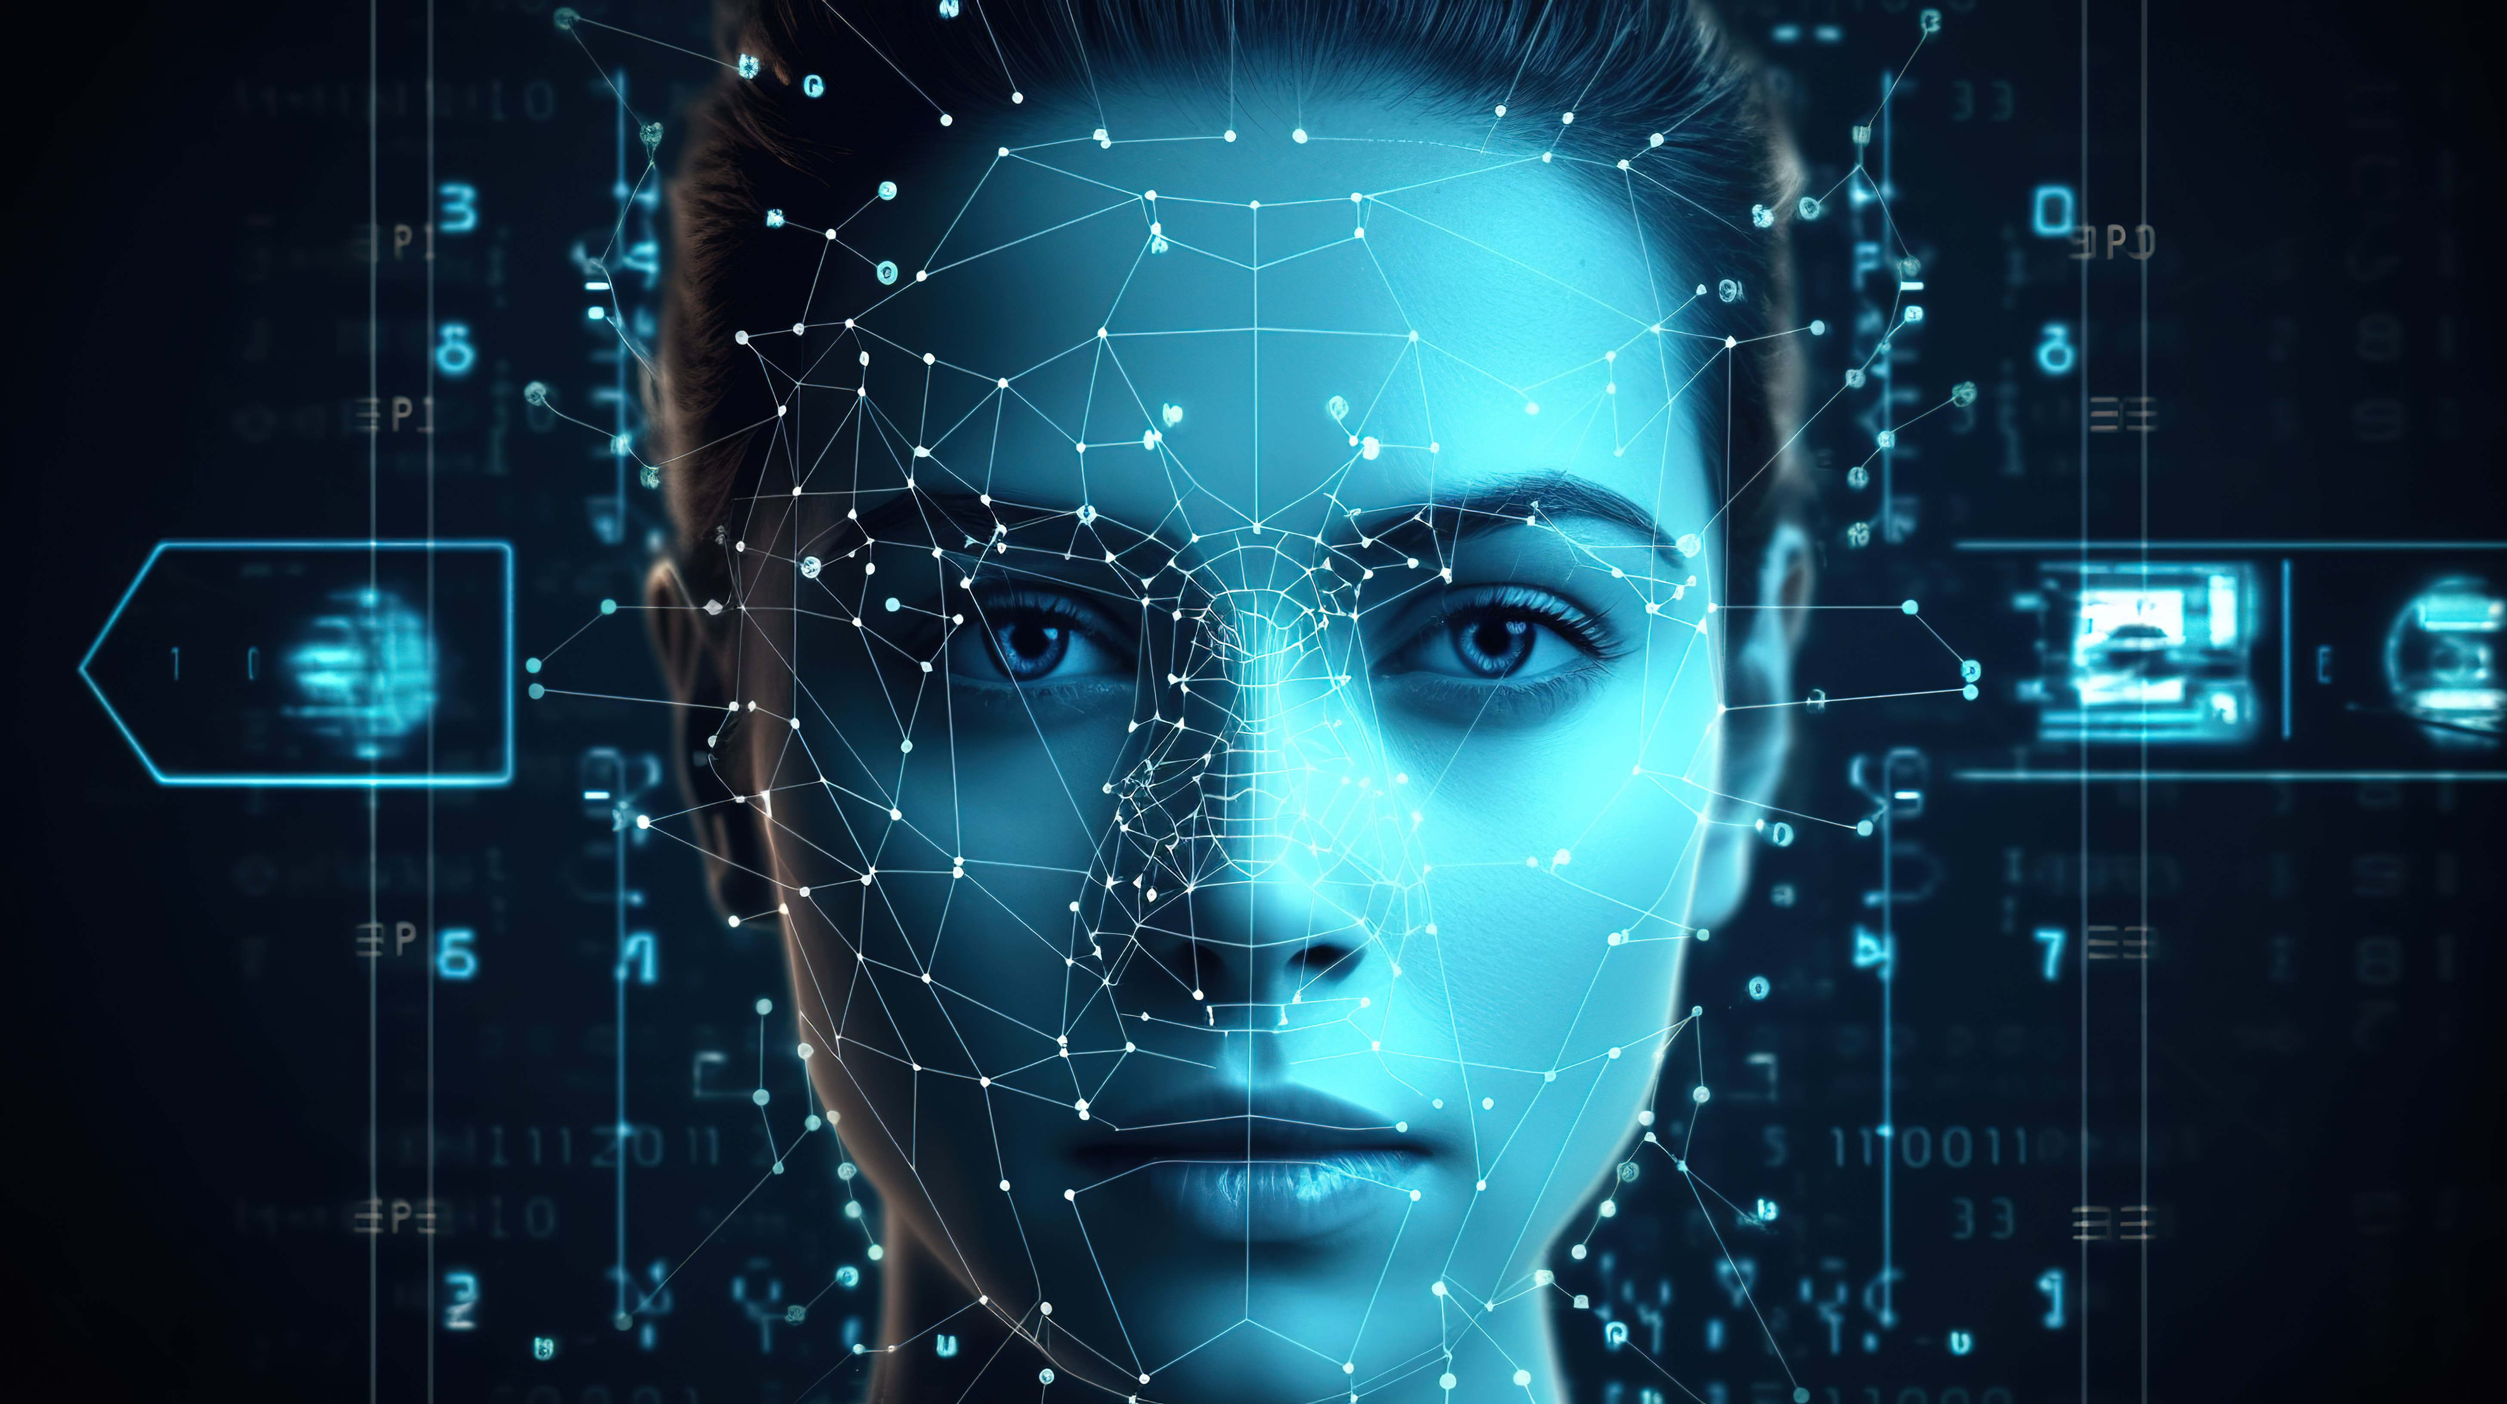
AI Face Detection
Name: Garima Agrawal – 100004523, Shreeraj Patil – 100004823,
Abhishek Negi – 100004670,
Nirbhay Rohatgi – 100003084
Subject – Artificial Intelligence
University – SRH Hochschule Leipzig

Slide 2



CONTENTS
01
Business Understanding
02
Data Understanding
03
Data Preparation
04
Modeling
05
Evaluation
06
Deployment & Monitoring
07
Summary

Slide 3
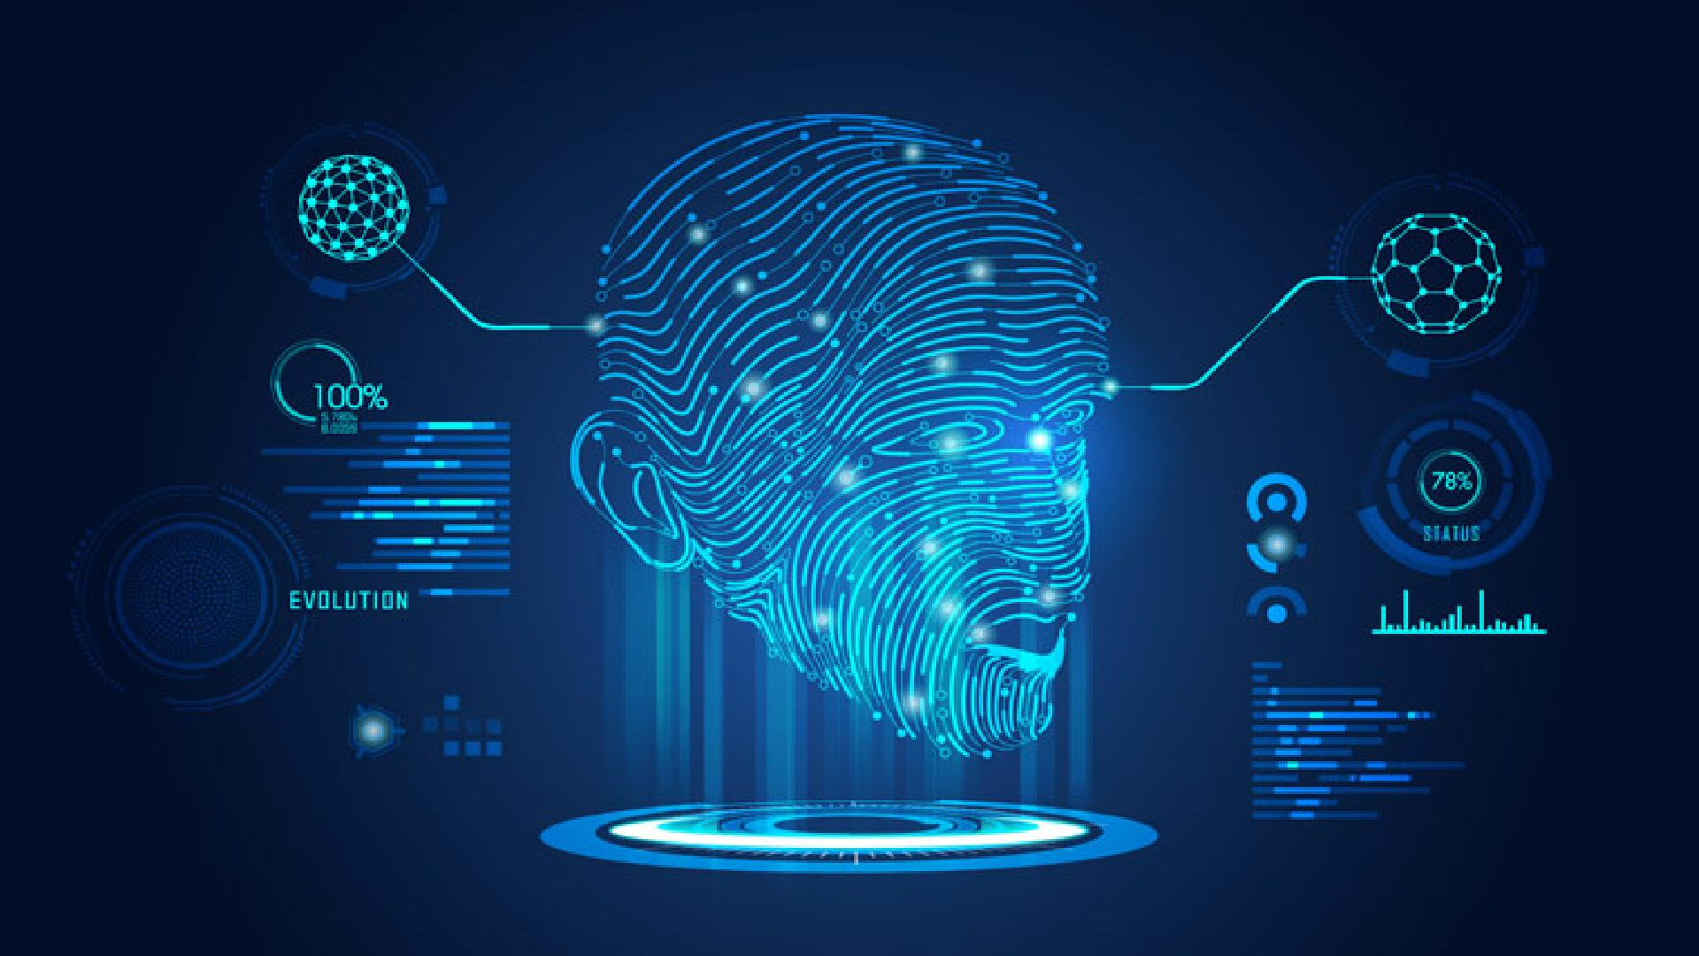
01. Business Understanding

Slide 4
The Digital Learning Engagement Gap
Traditional platforms track clicks and time-on-task but miss critical emotional signals, leaving confusion and frustration undetected.
The Problem: Emotional Blindness
Our Solution: AI-Powered Insight
Cannot identify when a learner is confused or frustrated.
Unable to detect increasing boredom or disengagement.
Miss content-triggered positive or negative reactions.
Fail to notice when attention drops, leading to dropouts.
Integrates real-time facial-expression analysis via webcam.
Turns unseen emotions into actionable data.
Enables immediate pedagogical intervention.
Closes the emotional feedback loop to improve retention.

Slide 5
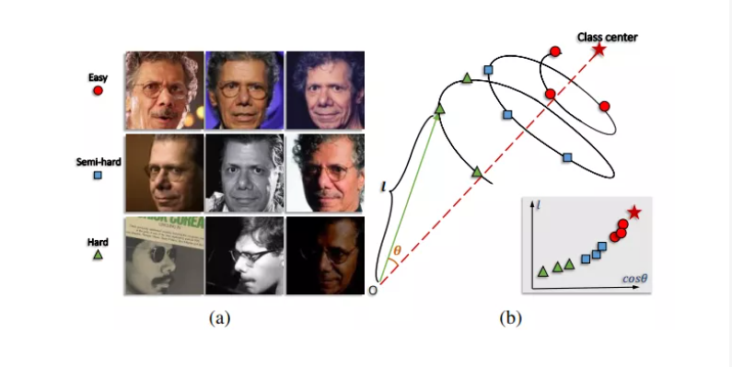
AI Emotion Recognition Engine
We train convolutional models on FER and CK+ datasets to classify expressions, delivering low-latency insights for live learning environments.
Emotion Classes
Angry, Disgust, Fear, Happy, Neutral, Sad, Surprise.
Real-Time Performance
Webcam Input
AI Processing
Live Dashboard
Inference speed of ≤150 ms per frame.

Slide 6
02. Data Understanding

Slide 7
Data Understanding
Data Source(s) :
https://www.kaggle.com/datasets/msambare/fer2013
✓ Found train directory: data/fer2013/train
✓ angry : 3995 images
✓ disgust : 436 images
✓ fear : 4097 images
✓ happy : 7215 images
✓ sad : 4830 images
✓ surprise : 3171 images
✓ neutral : 4965 images
Training set: 28,709 images
Test set: 7,178 images
Total: 35,887 images
Dataset Characteristics:

Slide 8
Quality Audit Findings
Summarizes data quality issues identified during facial image dataset profiling, highlighting factors that directly impact emotion recognition accuracy, bias, and model reliability.
Near-Duplicate Faces
~15%
Low-Quality Samples
~8%
Blurred faces, poor lighting, occlusions (masks, glasses, hands)
Multiple frames of the same subject with minimal variation
High
Label Inconsistency
Anomalous
Distribution Shifts
Ambiguous or mixed facial expressions
Underrepresentation of rare or subtle emotions (e.g., fear, disgust)

Slide 9
03. Data Preparation

Slide 10
Cleaning & Integration Pipeline
Defines the automated preprocessing and data integration steps applied to facial image and video data to ensure consistency, quality, and reproducibility before training the emotion recognition model.
Raw Data
Transformations
Integrated Data
Kaggle Sources
Clean & Standardize
Unified Emotion Dataset
All preprocessing steps logged and version-controlled Dataset versions traceable to original sources and annotations. Enables reproducibility, auditability, and rollback if quality issues arise

Slide 11
Challenges: Schema Drift
Explains how changes in data characteristics and annotation standards over time impacted model performance, how drift was detected, and what controls were implemented to ensure pipeline stability.
The Problem
The Solution
→
New facial data introduced variations in lighting, pose, camera quality, and demographics not present in the original training set. Model accuracy declined gradually without obvious pipeline failures
Implemented automated drift detection on input features and emotion distributions. Added label consistency checks and inter-annotator agreement monitoring. Established retraining and validation triggers when drift thresholds are exceeded

Slide 12
04. Technical Part

Slide 13
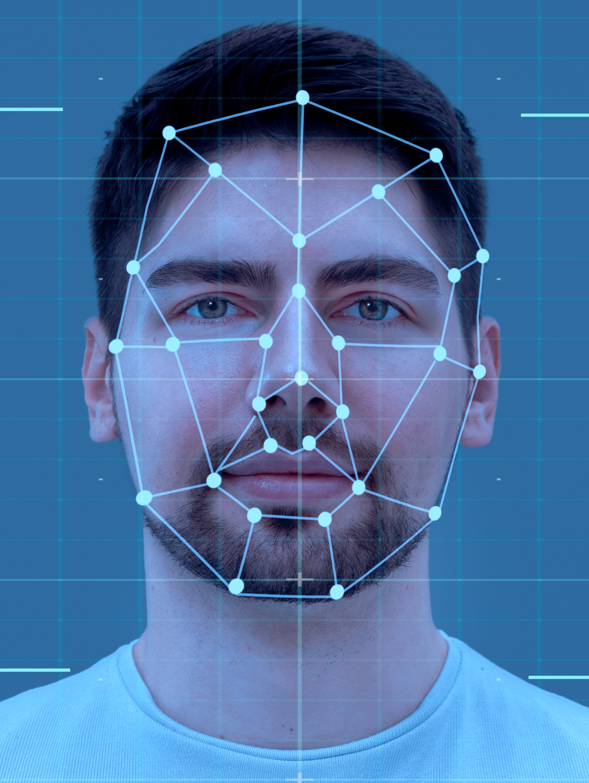
Facial Recognition as the Foundation
Facial Recognition Technology
Detects and tracks facial landmarks
Eyes
Mouth
Eyebrows
Converts facial movements into measurable features
Serves as the input layer for emotion classification models
Reality check: Facial recognition ≠ emotion detection, but emotion detection depends on it.

Slide 14
Key considerations
Role of Machine Learning
Convolutional Neural Networks (CNNs)
Deep Learning Frameworks
Variability in Human Expressions
Data Privacy Concerns
Machine Learning Algorithms
Learn emotion patterns from labeled facial images
Improve performance with more data
Adapt to variations in expressions and lighting conditions
Key idea: No learning → no emotion recognition.
Why CNNs for Emotion Detection?
Automatically extract facial features
Capture spatial patterns in images
Highly effective for subtle expression changes
CNNs are the industry standard, not optional.
Model Development Tools
TensorFlow: Scalable and production-friendly
PyTorch: Flexible and research-oriented
Enable rapid experimentation and model optimization
Frameworks don’t make models smart — data and design do.
Key Technical Challenge
Facial expressions vary by:
Individual
Mood
Context
Same face ≠ same emotion every time
This is the core reason accuracy is never 100%.
Ethical and Legal Challenges
Facial data is sensitive biometric information
Risk of misuse and surveillance
Must comply with data protection regulations (e.g., GDPR)
Emotion detection without ethics = guaranteed backlash.

Slide 15
05. Modelling

Slide 16

Train Model (2-4 Hours on GPU)
What it does:
✅ Checks GPU availability
✅ Builds CNN architecture
✅ Applies data augmentation
✅ Trains for 50 epochs
✅ Saves best model
✅ Generates training plots
Run:
python face_emotion_system.py
Total training time: 3.45 hours
Expected output:
✓ Best results:
Epoch: 38/50
Validation Accuracy: 0.6923 (69.23%)
Validation Loss: 0.8234

Slide 17
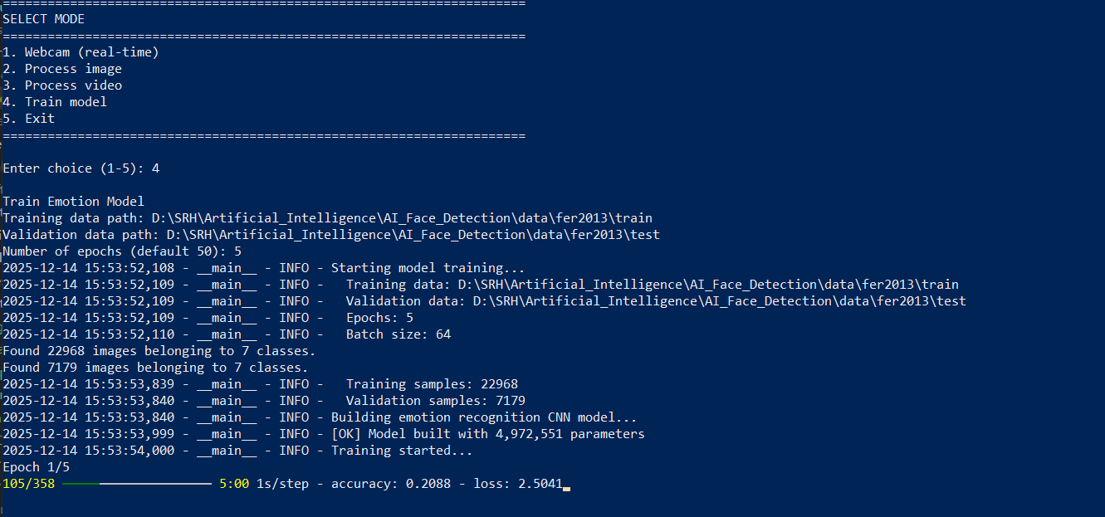
Train Model – Expected output 1.1

Slide 18
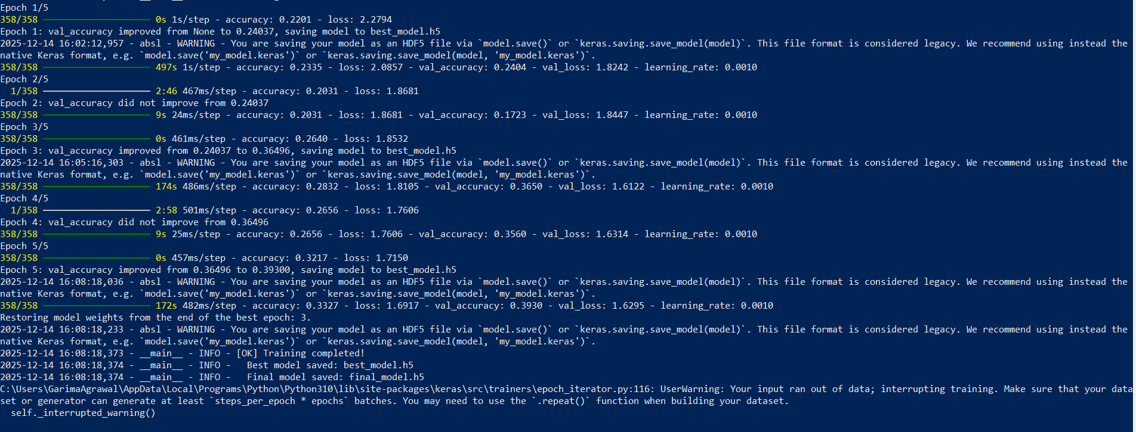
Train Model – Expected output 1.2

Slide 19
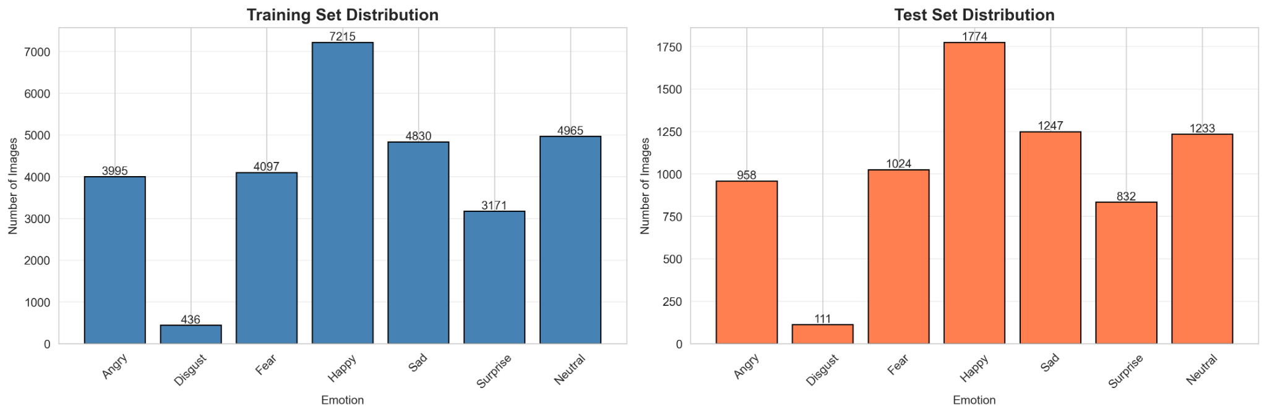
Dataset Distribution (FER2013)
Severe Class Imbalance
Happy and Neutral dominate both training and test sets
Disgust is extremely underrepresented, making it the rarest class
Consistent Distribution Across Splits
The relative proportions of emotions remain similar between training and test sets
This indicates a stratified split, reducing evaluation bias
Emotion-wise Breakdown
Happy: Largest class → model likely biased toward predicting happiness
Neutral & Sad: Well-represented but still secondary to Happy
Angry & Fear: Moderate representation
Surprise: Lower representation
Disgust: Critically low sample count → high risk of poor recall

Slide 20
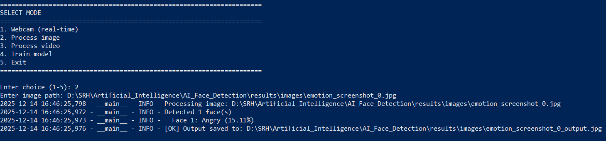
Test Model – 2. Process Image

Slide 21
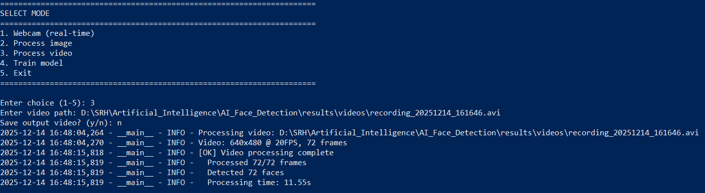
Test Model – 3. Process Video

Slide 22
Generating classification report
Emotion | Precision | Recall | F1-Score | Support
Angry | 0.6521 | 0.6234 | 0.6374 | 958
Disgust | 0.7134 | 0.4523 | 0.5543 | 111
Fear | 0.5823 | 0.5534 | 0.5675 | 1024
Happy | 0.8534 | 0.8712 | 0.8622 | 1774
Sad | 0.6312 | 0.6123 | 0.6216 | 1247
Surprise | 0.7823 | 0.8234 | 0.8023 | 831
Neutral | 0.6834 | 0.7012 | 0.6922 | 1233
Macro Avg | 0.6997 | 0.6624 | 0.6768 | 7178
Weighted Avg | 0.7123 | 0.6845 | 0.6972 | 7178

Slide 23

Live Testing (Real-time)
What it does:
✅ Loads trained model
✅ Runs real-time webcam detection
✅ Shows live statistics
✅ Tracks emotion distribution
✅ Exports analytics data
Run:
python realtime_emotion_analytics.py
What you'll see:
Live video with:
- Face detection boxes
- Emotion labels with confidence
- Real-time statistics panel
- Emotion distribution bars
- Recent trend analysis (last 10 seconds)
- FPS counter

Slide 24
Understanding Our Dataset Results
What's Good Performance?
FER2013 Benchmarks:
Human performance: ~65%
Our target: 65-70%
State-of-the-art: ~73%
Test Accuracy | Status | Interpretation
≥ 70% | ⭐⭐⭐ Excellent | Above human baseline!
65-70% | ⭐⭐ Very Good | Matches state-of-the-art
60-65% | ⭐ Good | Acceptable for deployment
< 60% | ⚠️ Needs work | Consider retraining
Issue 1: Out of Memory (GPU)
# Reduce batch size in train_model.py
CONFIG = {
'batch_size': 32, # Instead of 64
...
}
Issue 2: Training Too Slow
# Check GPU is being used
python -c "import tensorflow as tf; print(tf.config.list_physical_devices('GPU'))"
Troubleshooting

Slide 25
06. Deployment & Monitoring

Slide 26

📁 Project Structure
├── prepare_fer2013_data.py
├── train_model.py
├── test_model.py
├── realtime_emotion_analytics.py
├── face_emotion_system.py
├── data/
│ └── fer2013/ # Download from Kaggle
│ ├── train/
│ │ ├── angry/
│ │ ├── disgust/
│ │ ├── fear/
│ │ ├── happy/
│ │ ├── sad/
│ │ ├── surprise/
│ │ └── neutral/
│ └── test/
│ └── (same structure)
├── models/
├── logs/
└── results/

Slide 27
Production Architecture
→
→
→
Kaggle Dataset
Train Model
Test Model
Live Testing
✅ Training completes without errors
✅ Test accuracy is acceptable (> 60%)
✅ Live detection works on webcam
Quantitative Results
✅ Test accuracy: ~65-70%
- ✅ Per-class precision/recall/F1
- ✅ Confusion matrix
- ✅ Training curves
- ✅ Real-time performance (FPS)

Slide 28
07. Summary

Slide 29
Project Summary: AI-Based Facial Emotion Detection Using FER-2013
Success Criteria:
models/emotion_model.h5 (9.4 MB trained model)
Test accuracy > 65% (matching state-of-the-art)
15+ visualization files
10+ data export files
Live webcam detection working

Slide 30




Merry Christmas & Happy Holidays! 🎄

